Slide 1
Fake News: From Definition to Identification
Baurjan Safi
General Assembly, Data Science Immersive-5
September 2017

Slide 2
Plan of Presentation
“Fake News” Definition
Data and EDA
Machine Learning Results
Conclusions and Recommendations
Discussion

Slide 3
Definition of Fake News
Fake news
A type of journalism or propaganda that consists of deliberate misinformation or hoaxes spread via traditional print and broadcast news media or online social media.
Fake news is written and published with the intent to mislead in order to gain financially or politically, often with sensationalist, exaggerated, or patently false headlines that grab attention
Wikipedia

Slide 4
Data and EDA
Initial dataset of fake news found on Kaggle.com
12,999 observation over the past year.
Over 200 news resources from a wide specter of political affiliations.
DataCamp.com article by Katharine Jarmul (Berlin)
6,000 observations (3k – Real, 3K – Fake)
Unspecified sources
Mostly political articles
“Real” news scraped with help of “newspaper” Python package
Over 6,000 observations
From 15 news sites, mostly with high rank of credibility

Slide 5
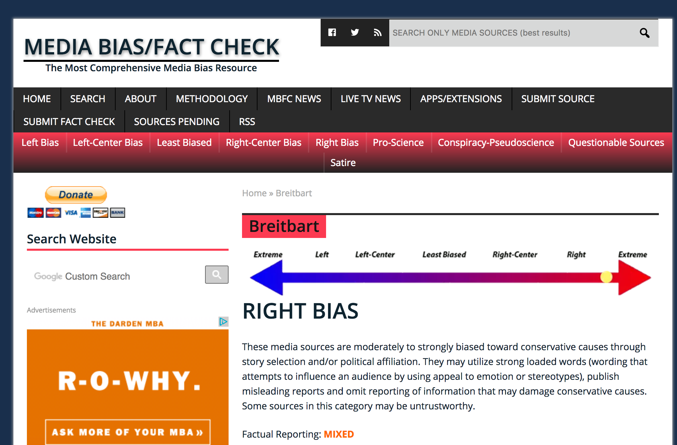
EDA
Media Bias and Fact Check:
Political affiliation:
Extreme Left
Left
Center Left
Center
Center Right
Right
Extreme Right
Credibility of the news source:
High
Mixed
Low
Conspiracy / Pseudoscience
Satire

Slide 6
Kaggle “Fake News” Dataset
Classification | Number
bs | 11492
bias | 443
conspiracy | 430
hate | 246
satire | 146
state | 121
junksci | 102
fake | 19

Slide 7
Kaggle “Fake News” Dataset
Dropped:
Other languages other than English
Other classes than 'bs’
All texts with length of less than 500 and longer than 12,000 signs
Ran it through all 215 news sources and determined about 140 on them on the political affiliation specter.

Slide 8
News Spread on a Political Specter

Slide 9
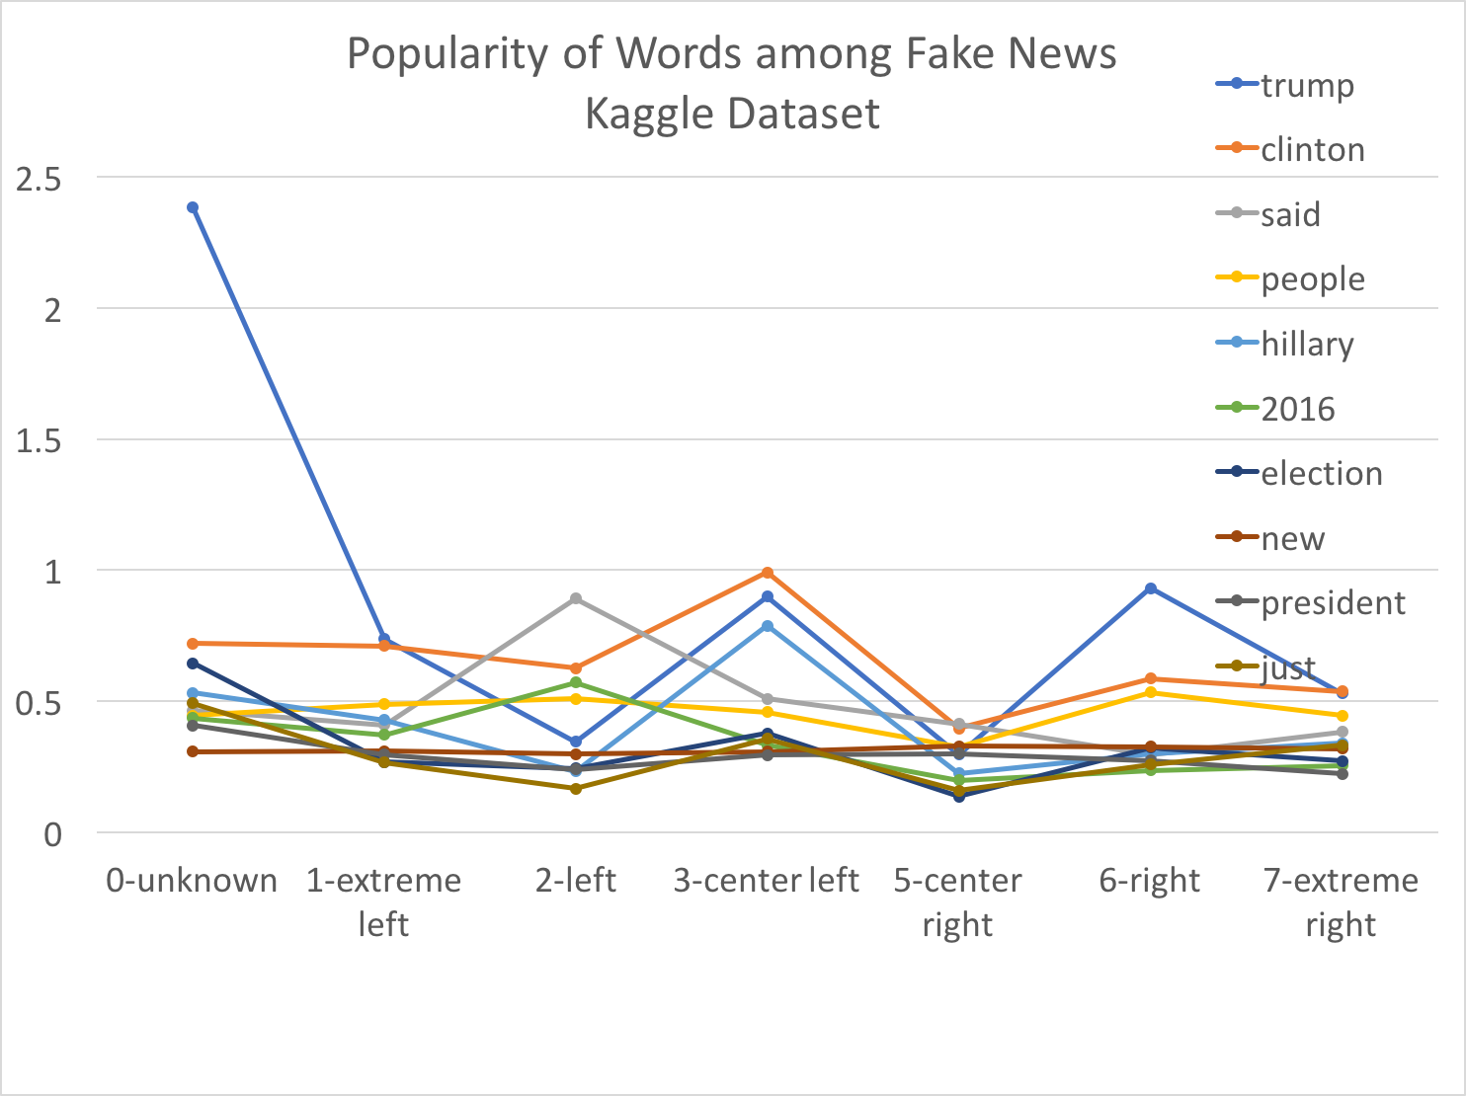
The list of the popular words across media

Slide 10
Methodology
Build Model with Multinomial Naïve Bayes on DataCamp’s dataset
Transform the Kaggle’s fake news dataset
Transform the scraped supposedly real news dataset
Merge the Kaggle and scraped datasets and refit the model on Multinomial NB
Compare other classification methods and compare the results

Slide 11
Results of Datacamp Dataset on Multinomial Naïve Bayes
Accuracy - 0.857

Slide 12
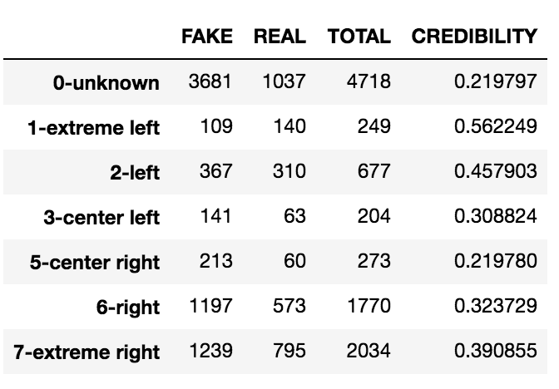
“Credibility” of the “Fake News”

Slide 13
Web Scraped “Real” News Cross-cut
Number of ”Real” News / Affiliation
Party Affiliation | # of News
0-unknown | 341
2-left | 1774
3-center left | 944
4-center | 1260
5-center right | 126
6-right | 1444
7-extreme right | 287

Slide 14
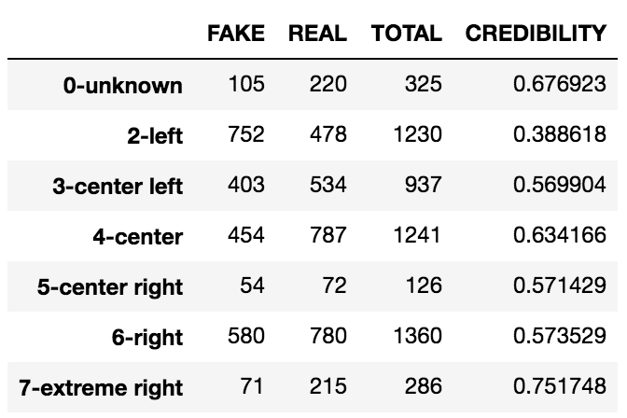
”Real” News on Multinomial Naïve Bayes

Slide 15
Merged Dataset on Multinomial Naïve Bayes
Accuracy - 0.735
Fake news correctly predicted ~ 100%
Real news correctly predicted - 0.28%

Slide 16
Other Algorithms
Algorithm | Accuracy Score
LinearSVC() | 0.907
RandomForestClassifier() | 0.909
GaussianNB() | 0.828
GradientBoostingClassifier() | 0.904

Slide 17
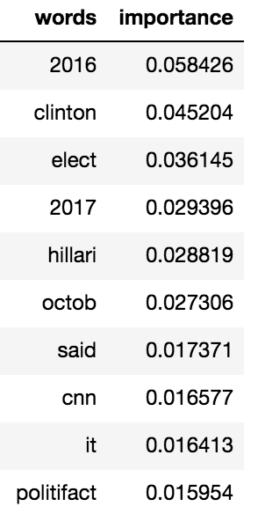
Random Forest
Correctly predicted
Fake news | 99%
Real news | 93%

Slide 18
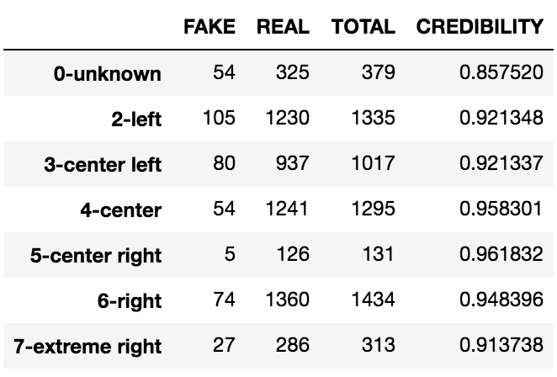
Media Credibility Across Political Specter

Slide 19
Validation Curve

Slide 20
Conclusions:
Using bag-of-words approach in identification of fake/real news proved as a valid approach for the given dataset and the dataset obtained through web-scraping.
Stemming and lemmatization decreases accuracy of prediction.
Multinomial Naive Bayes, although proven effective for predicting spam emails, did not show its effectiveness predicting fake news from real.
RandomForest algorithm showed better results and performed well on a wide range of features.
Importance features showed a strong influence of 2016 presidential elections

Slide 21
Further Steps
I did not exclude satire and conspiracy news from the set. Mostly because they are popular on social networks. I think that in the future those two subcategories shall be studied separately.
It would also be interesting to re-approach this subject with the word vectorizing techniques and see what topics can be identified in respect to political affiliation of a news source.

Slide 22
Questions

